Slide 1
Statistics
Standard Deviation

Slide 2
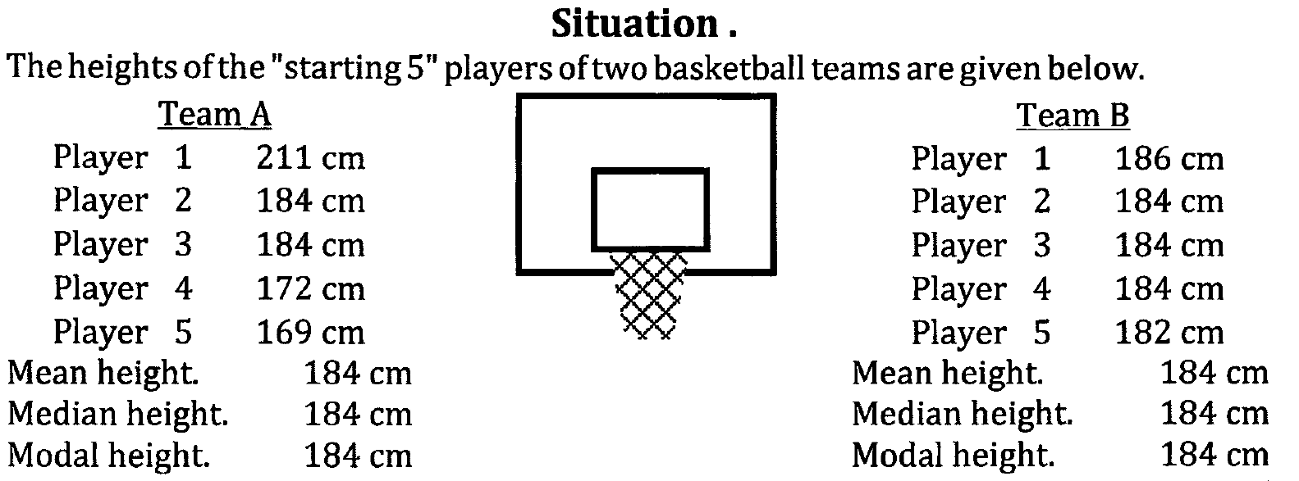
Using means and medians – MEASURES of CENTRAL TENDENCY

Slide 3
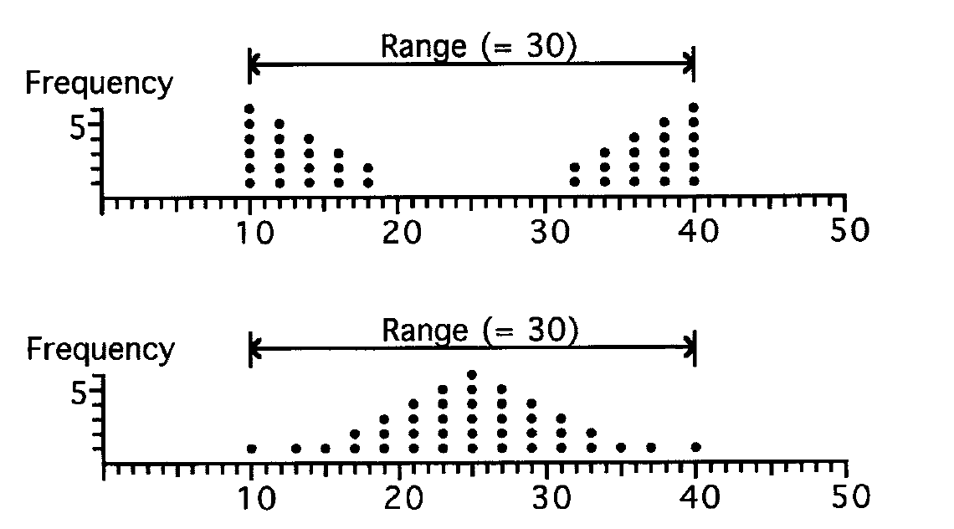
Measures of dispersion
Range can be used

Slide 4
Standard deviation
The Standard Deviation is a measure of how spread out numbers are.
The symbol use for Standard deviation is σ.
The standard deviation is actually the square root of the variance.
Use your calculator to calculate standard deviation (σ)

Slide 5
The heights of the 5 dogs (at the shoulders) are: 600mm, 470mm, 170mm, 430mm and 300mm.
Notes:
http://www.mathsisfun.com/data/standard-deviation.html

Slide 6
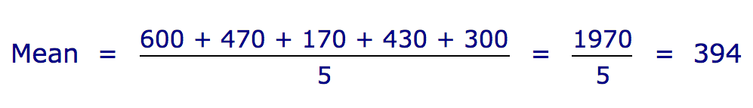
Standard deviation, $σ$ = 147.32 = 147 (to the nearest mm)
Notes:
http://www.mathsisfun.com/data/standard-deviation.html

Slide 7
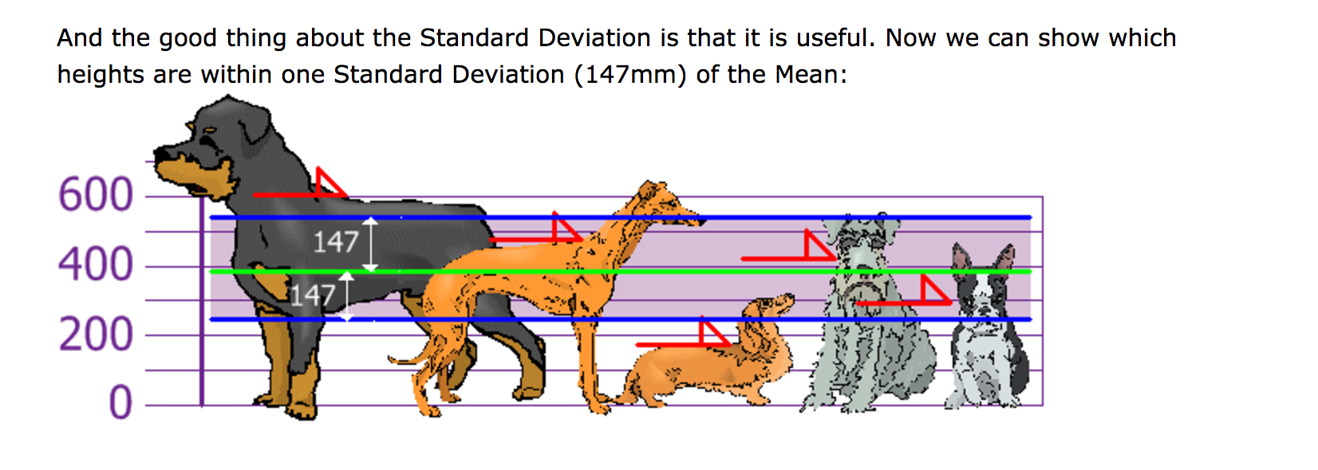
Standard deviation is a number used to tell how measurements for a group are spread out from the mean.
A low standard deviation means that most of the numbers are very close to the mean.
A high standard deviation means that the numbers are spread out.
Notes:
http://www.mathsisfun.com/data/standard-deviation.html

